Slide 1
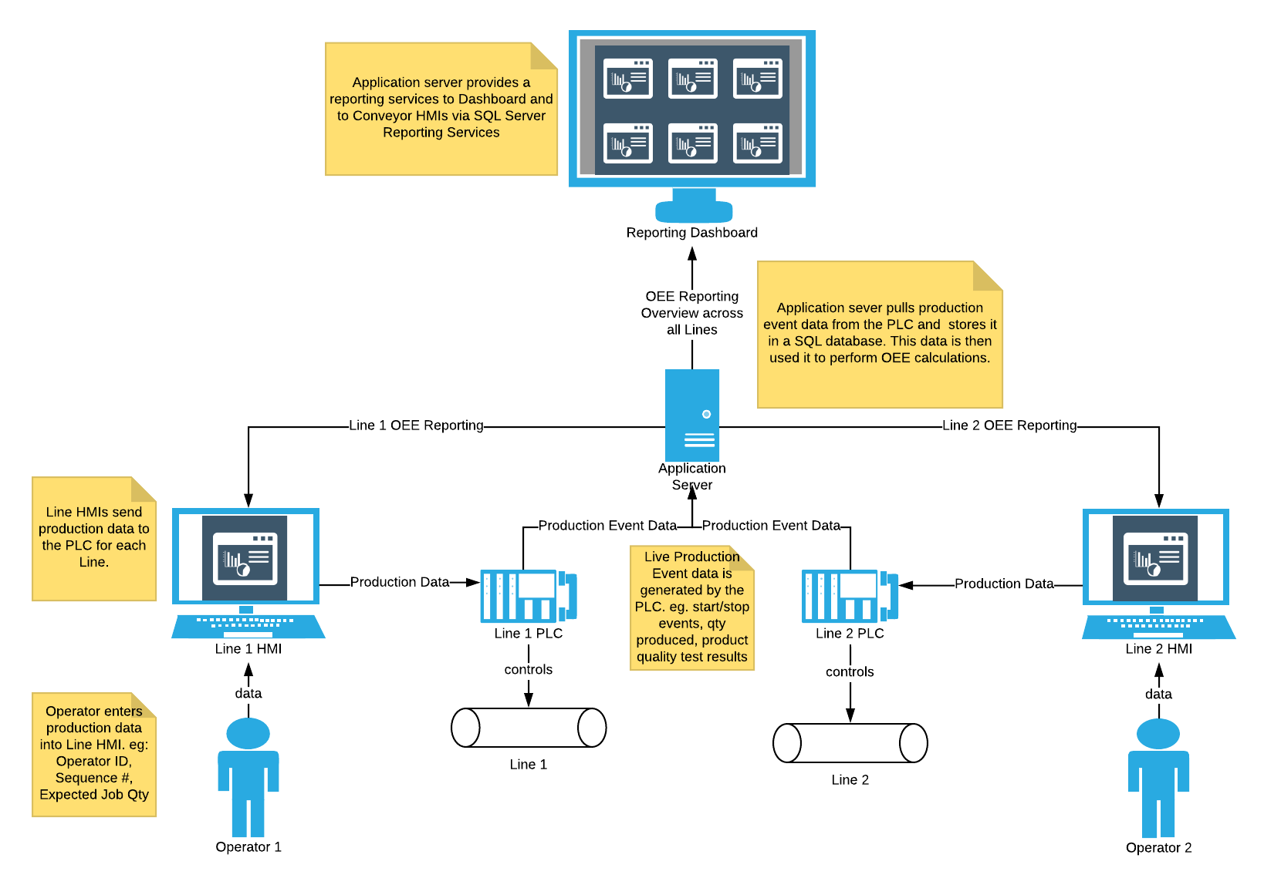
OEE System
July 2018

Slide 2
The Calculations
LM3 uses the standard OEE calculation based on 3 factors: Availability, Performance, and Quality. The formula for OEE is given by:
OEE = Availability x Performance x Quality
Availability
Availability is a measurement of the percentage of the Planned Production Time that a machine remained operational. Availability takes into account any unplanned or planned Stop Time. An example of an unplanned stop event is a machine breakdown. Examples of planned stop events are scheduled breaks and scheduled changeovers. The formula for Availability is given by:
Availability = Run Time / Planned Production Time
Where Run Time is given by:
Run Time = Planned Production Time – Stop Time
Performance
Performance is a measurement of the percentage of the maximum possible production speed that a machine was able to attain. Performance is based on the total number of units produced, Total Count, and the fastest possible time that the machine can produce one unit, Ideal Cycle Time. It does not take into account the number of good units produced, Good Count. Therefore, Performance values are not hurt by quality. The formula for Performance is given by:
Performance = (Ideal Cycle Time x Total Count) / Run Time
Quality
Quality is a simple measurement of the percentage of total number of units produced, Total Count, that met the quality standards, Good Count. The formula for Quality is given by:
Quality = Good Count / Total Count

Slide 3
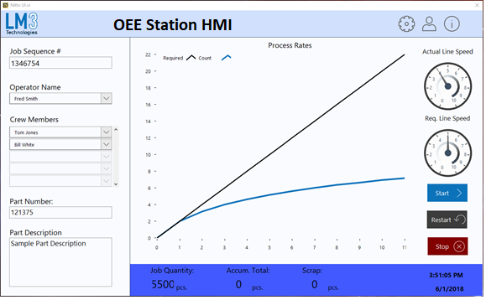
Station HMI
Running Status

Slide 4
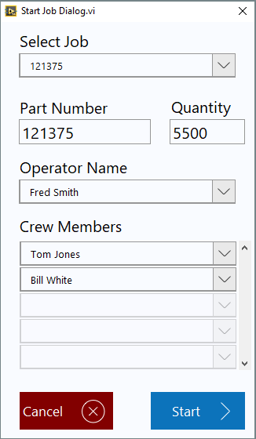
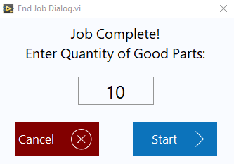
Station HMI
Monitor
End Job
Start Job
Start and Stop a Job

Slide 5
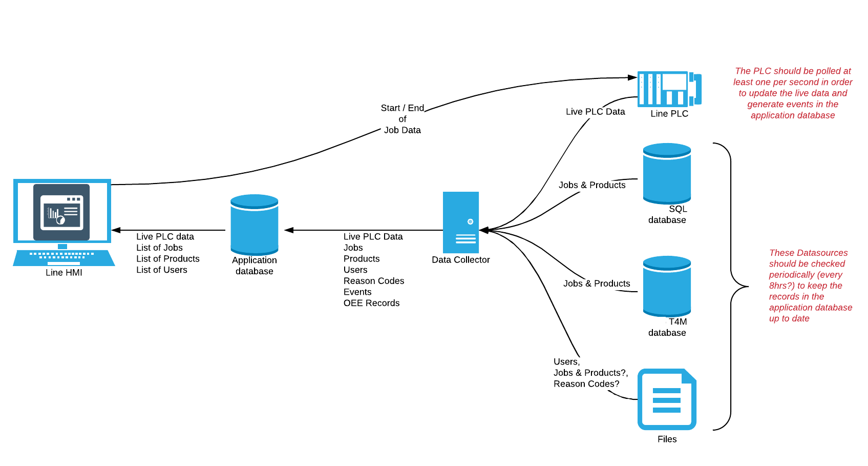
Station HMI
Data Flow

Slide 6
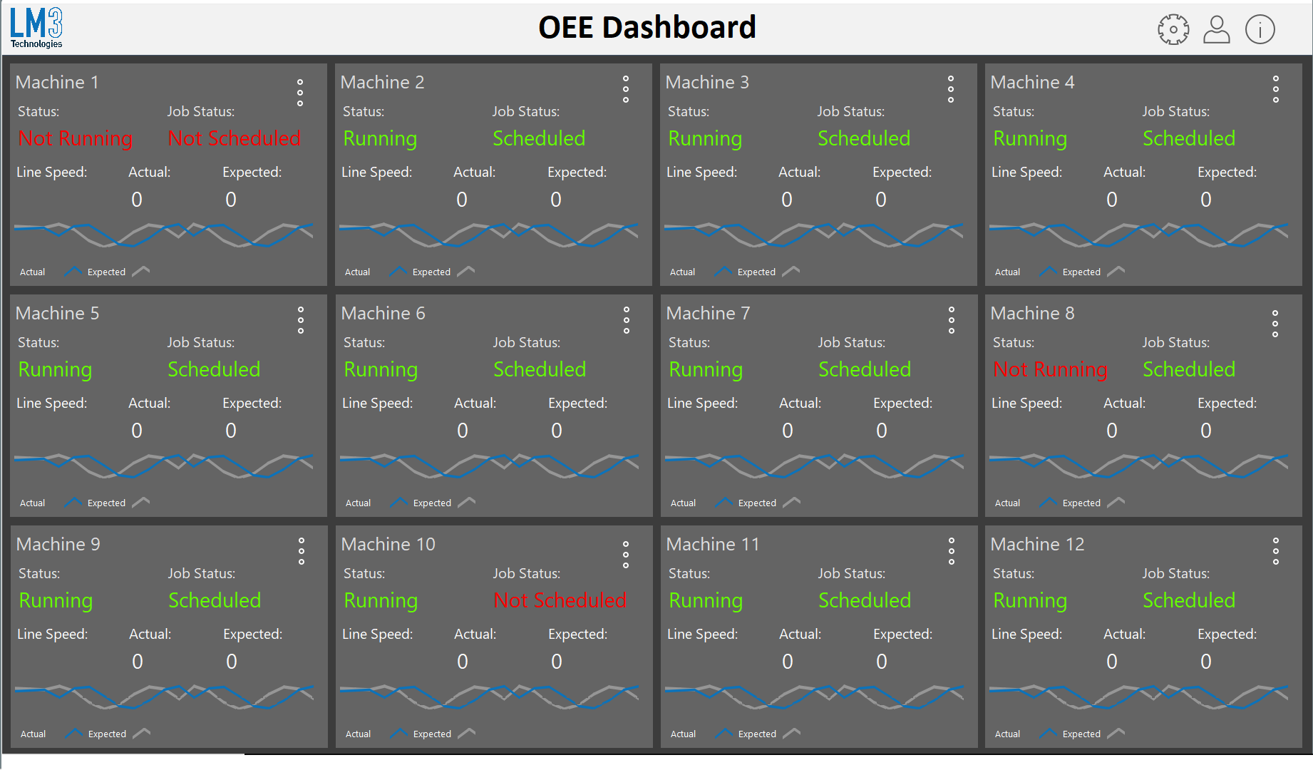
System Dashboard
Web Based View of All Stations

Slide 7
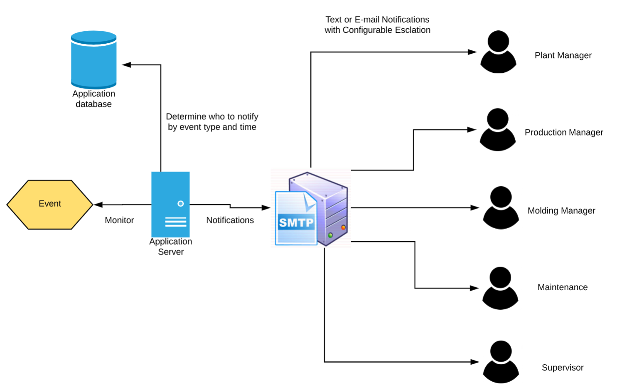
Notifications
Event Driven Text and E-mail Notifications

Slide 8
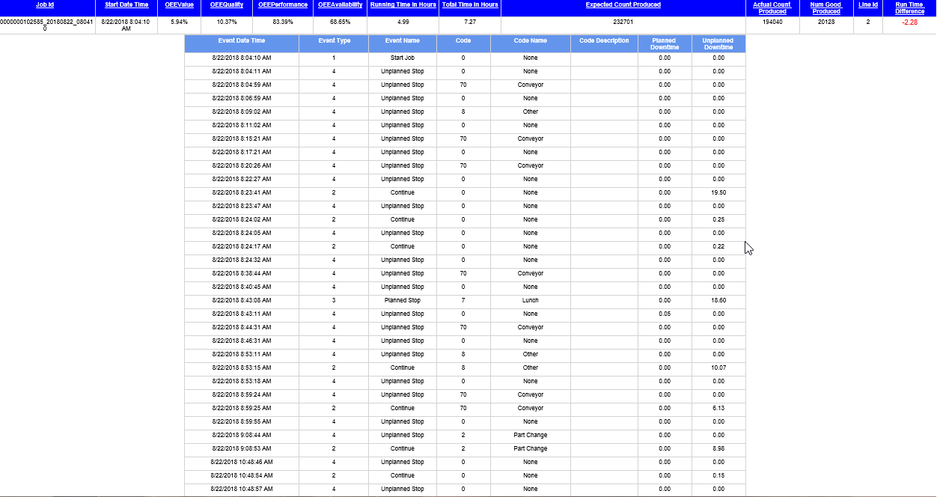
Reporting
OEE Report

Slide 9
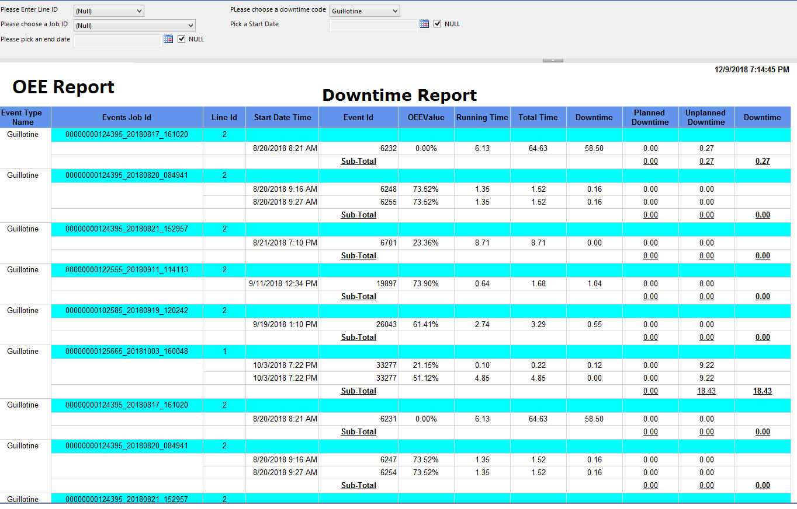
Reporting
Downtime Report

Slide 10
Reporting
Downtime by Reason

