Slide 1
mDAQ Mobile Data Collection Solution Product Overview

Slide 2
What is mDAQ?
A mobile data collection solution for manufacturing organizations
Eliminate paper forms
Leverage data for machine control
Make data easier to search and analyze
Long-term data storage
Collected data available via read-only API to your existing systems (e.g. MES, Databases, Reporting Tools)
Applications
Data Collection Forms
Process Verification
Visual Work Instruction
Data-driven Machine Control
mDAQ ≠ MES
mDAQ is NOT a Manufacturing Execution System (MES) and is not directly connected to MES. Data collection/verification with mDAQ can be done regardless of the MES being used via standardized API in a read-only configuration

Slide 3
What is Open Data Kit (ODK)?
Open source software framework
Mobile data collection in remote regions of the world without access to internet or cellular connections
Developed by Google and the University of Washington
mDAQ is powered by
http://docs.opendatakit.org/

Slide 4
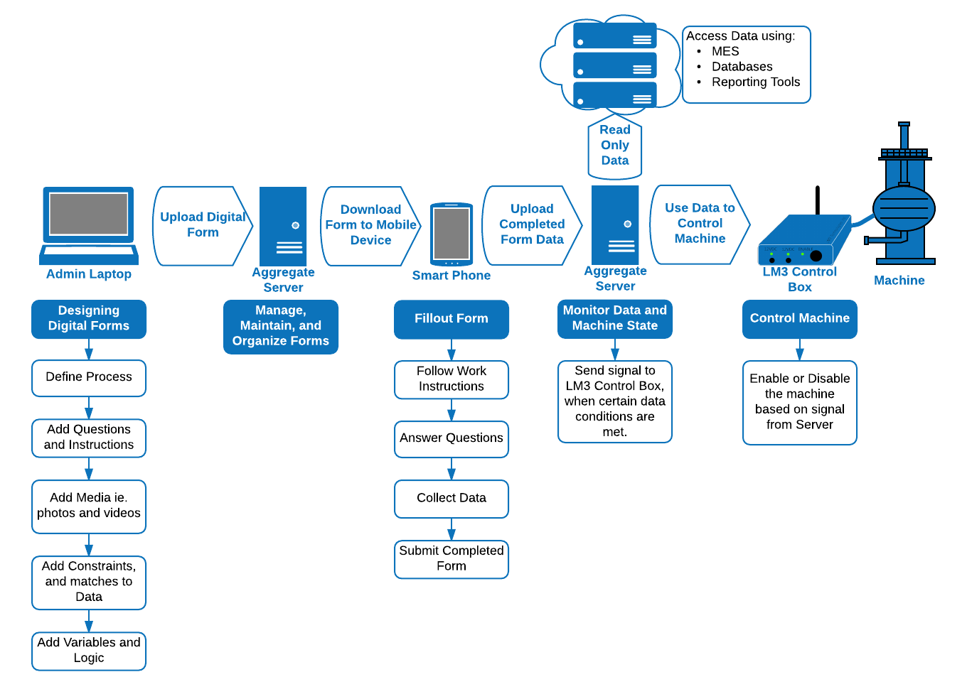
The mDAQ Data Flow

Slide 5
mDAQ FEATURES

Slide 6
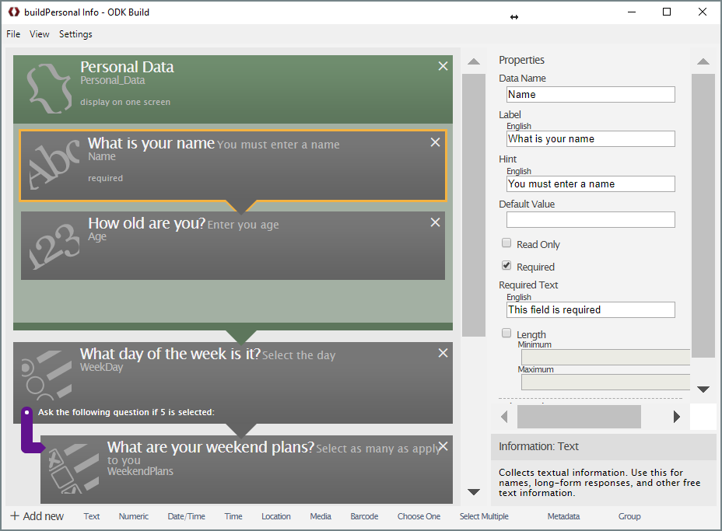
DESIGN
ODK Build (Visual Editor)
XLSFORM (MS Excel-based editor)
type | name | label::English
begin group | Personal_Data | Personal Data
text | Name | What is your name
integer | Age | How old are you?
end group
select_one choices_WeekDay | WeekDay | What day of the week is it?
select_multiple choices_WeekendPlans | WeekendPlans | What are your weekend plans?
AND/OR
Support intelligent data collection by considering:
Constraints on data, Relevancy of data, Data matches to expected values, Look-ups based on data, Jump / Skip Logic, Data variables

Slide 7
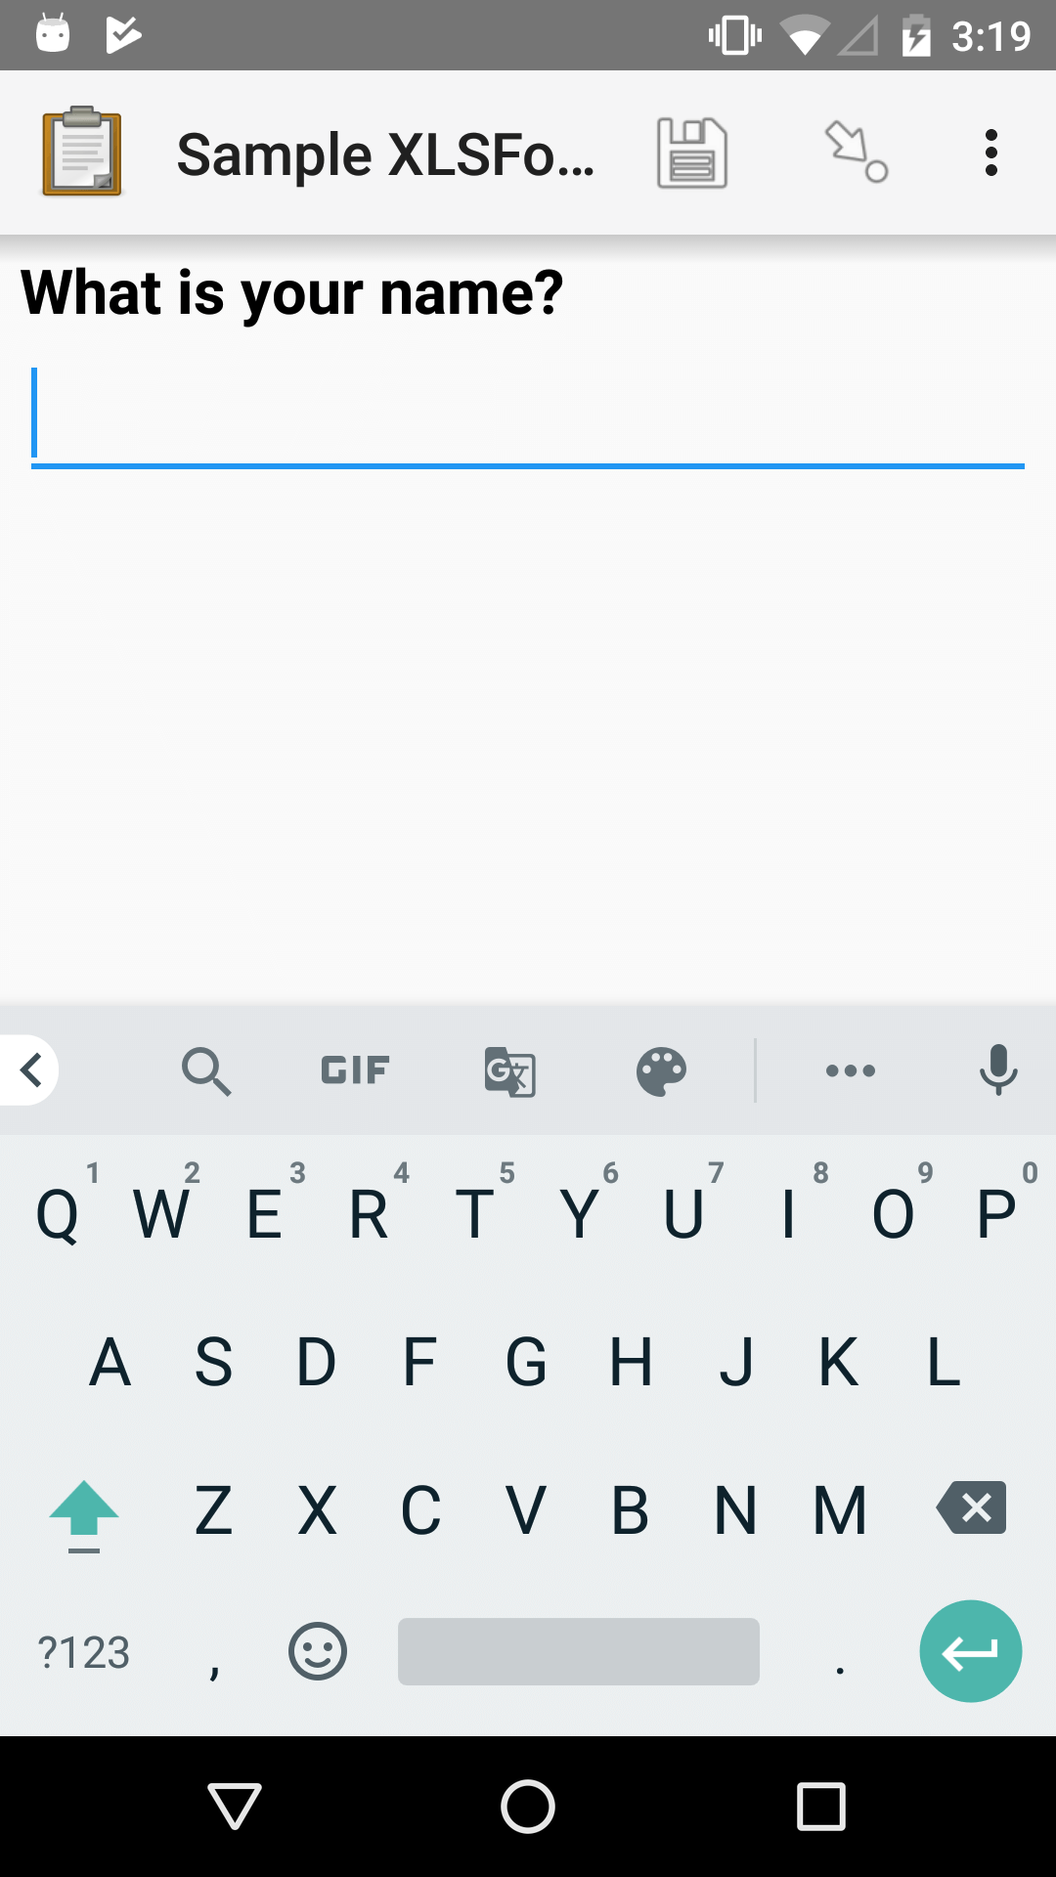
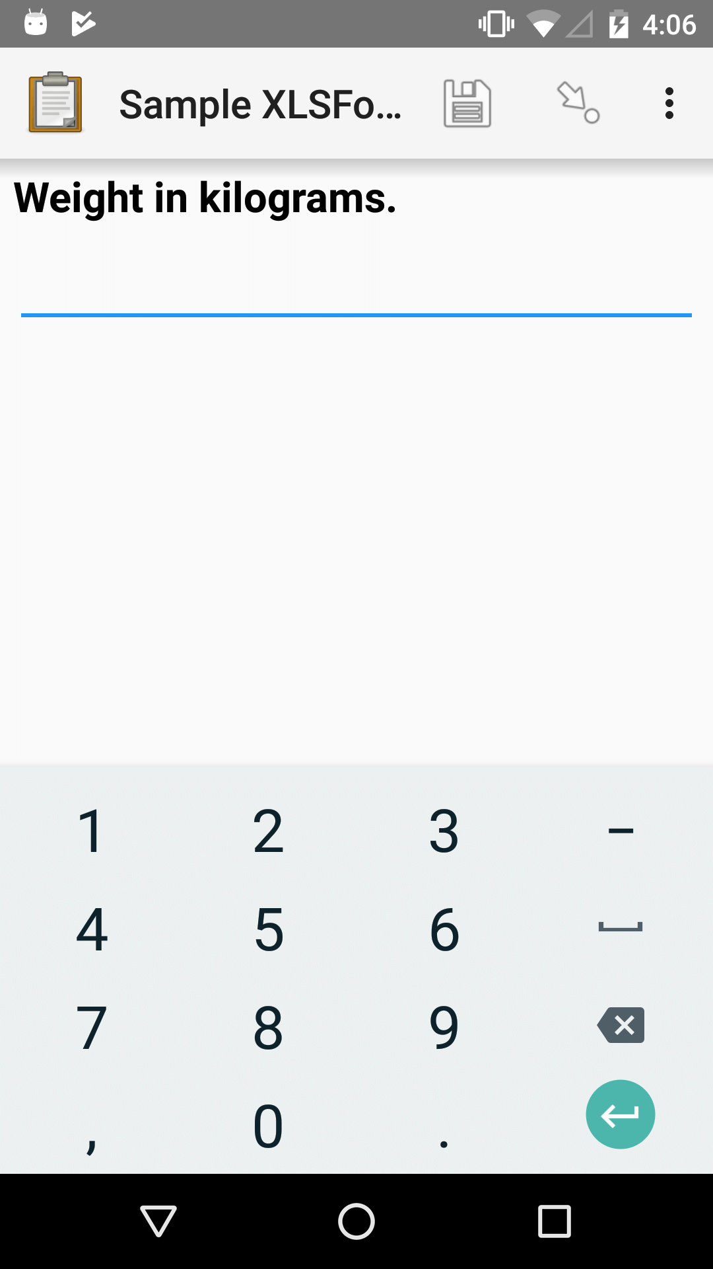
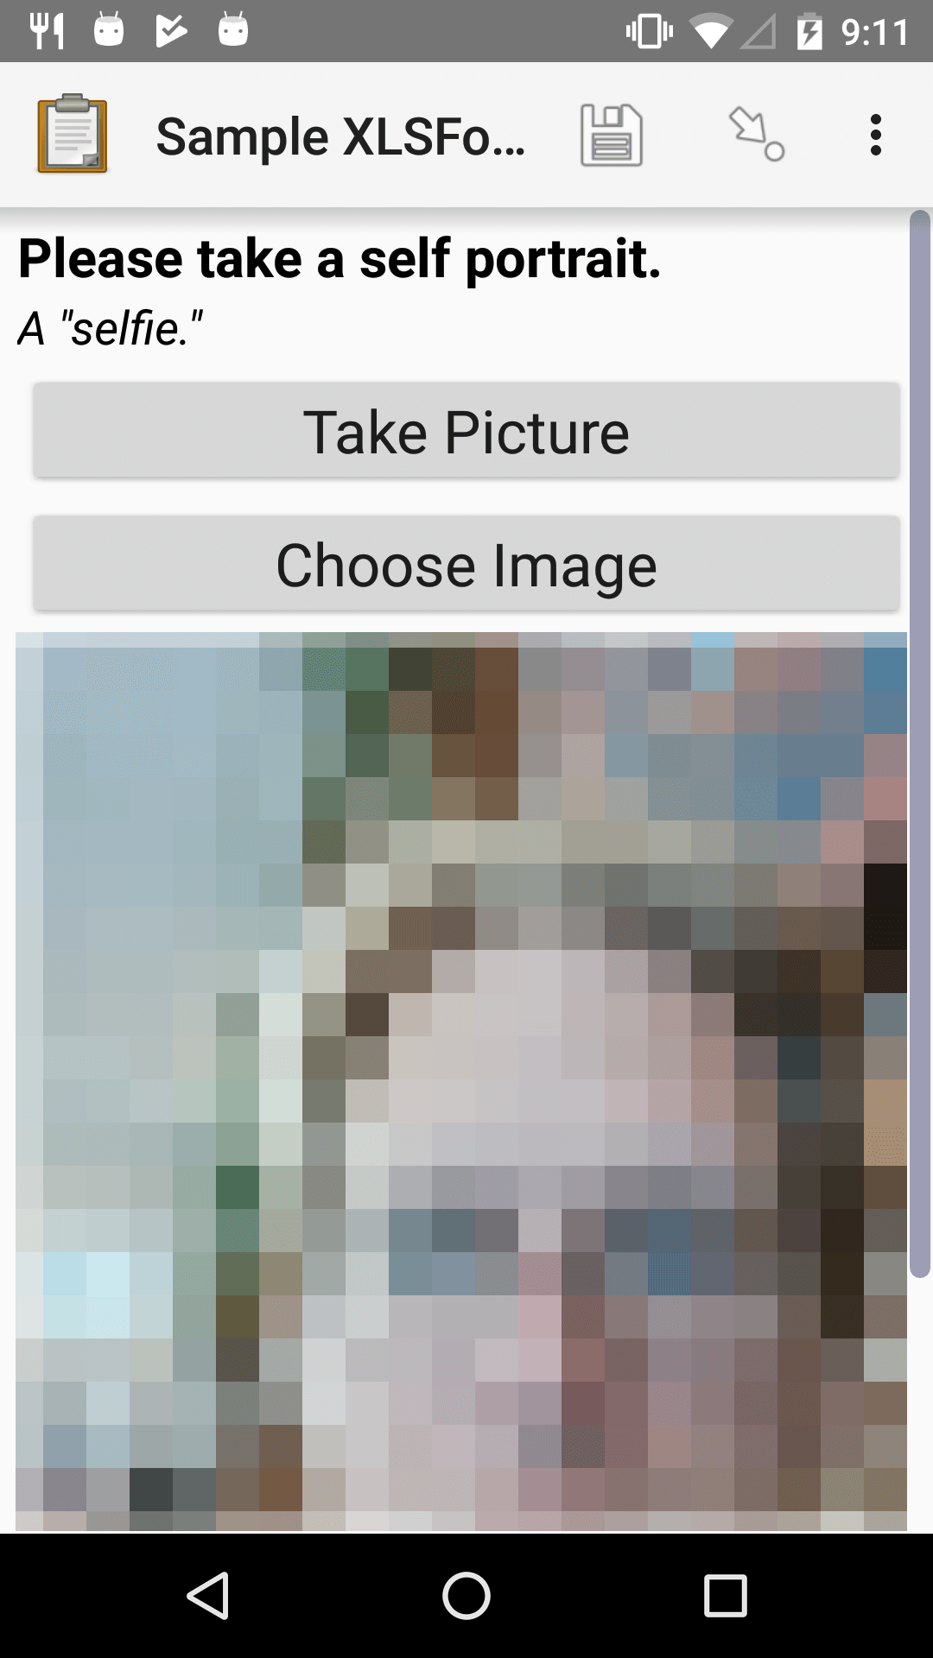
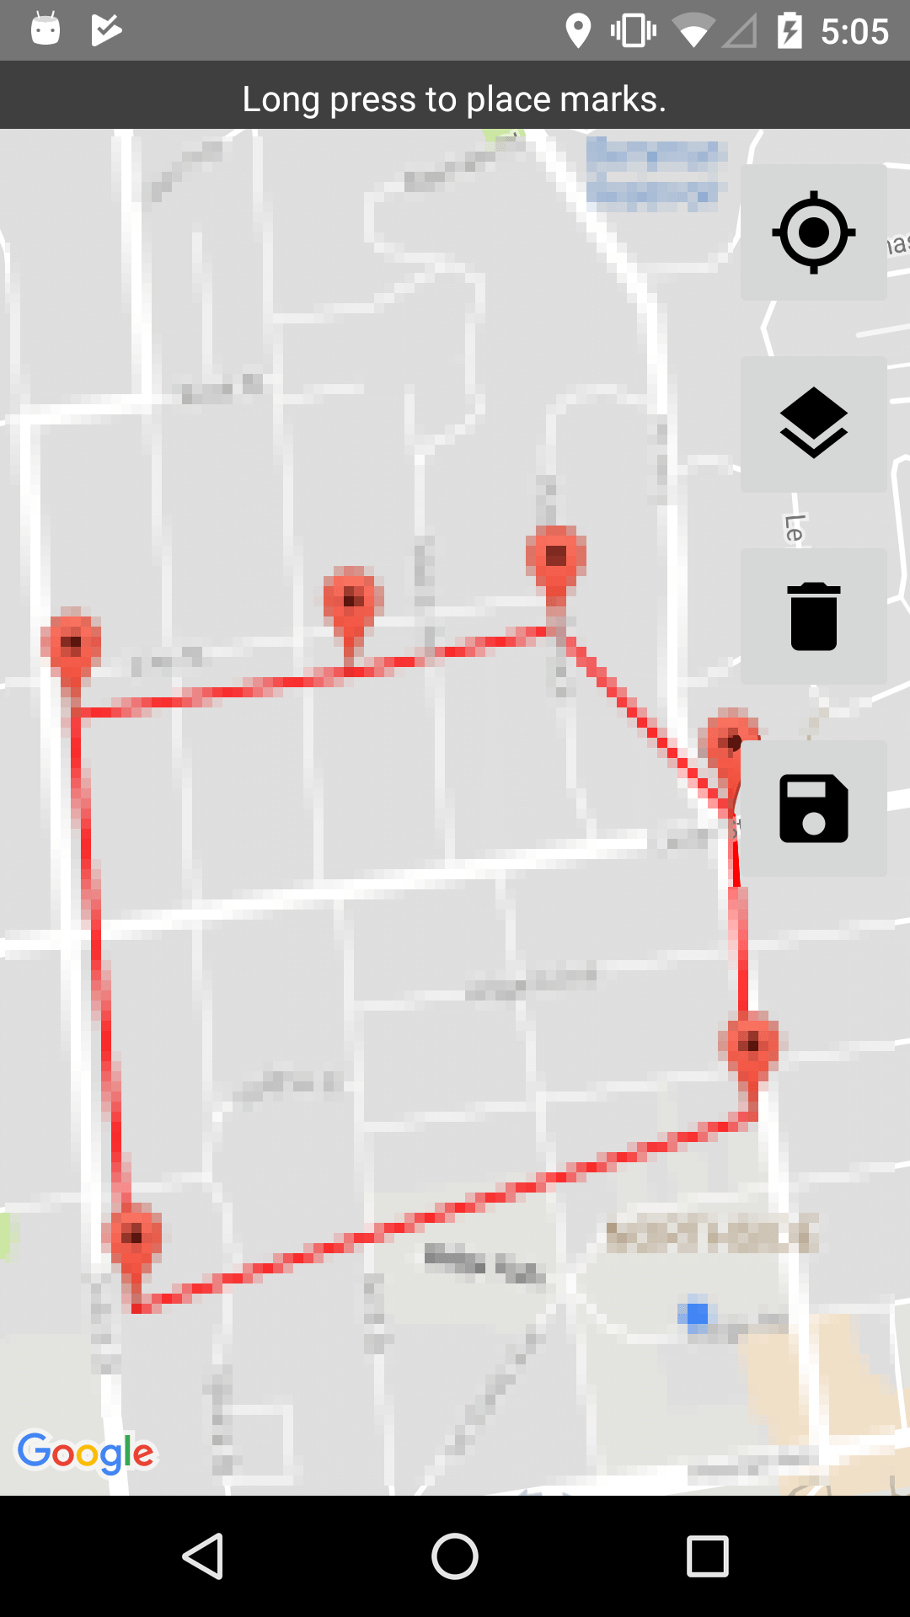
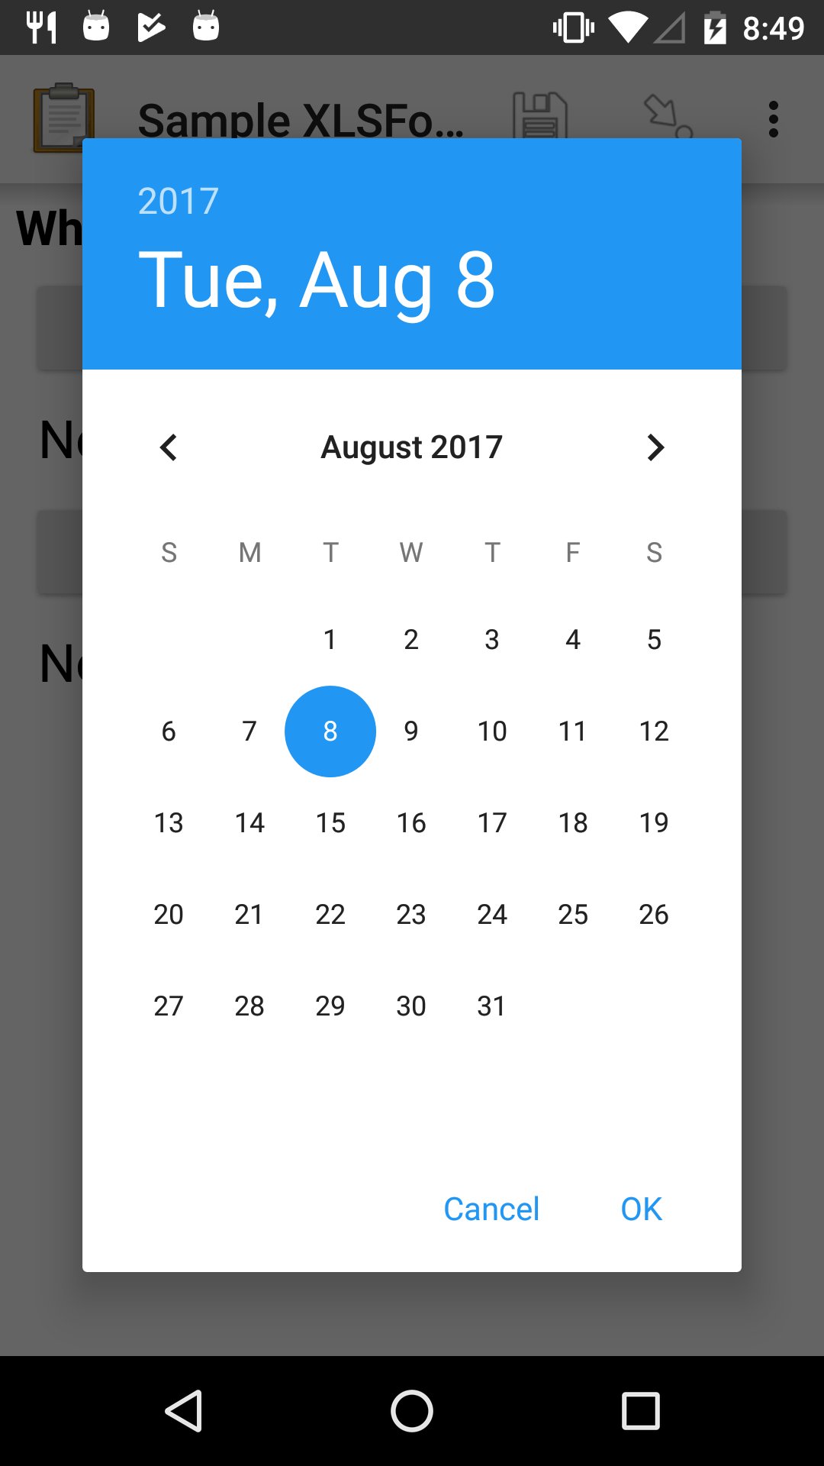
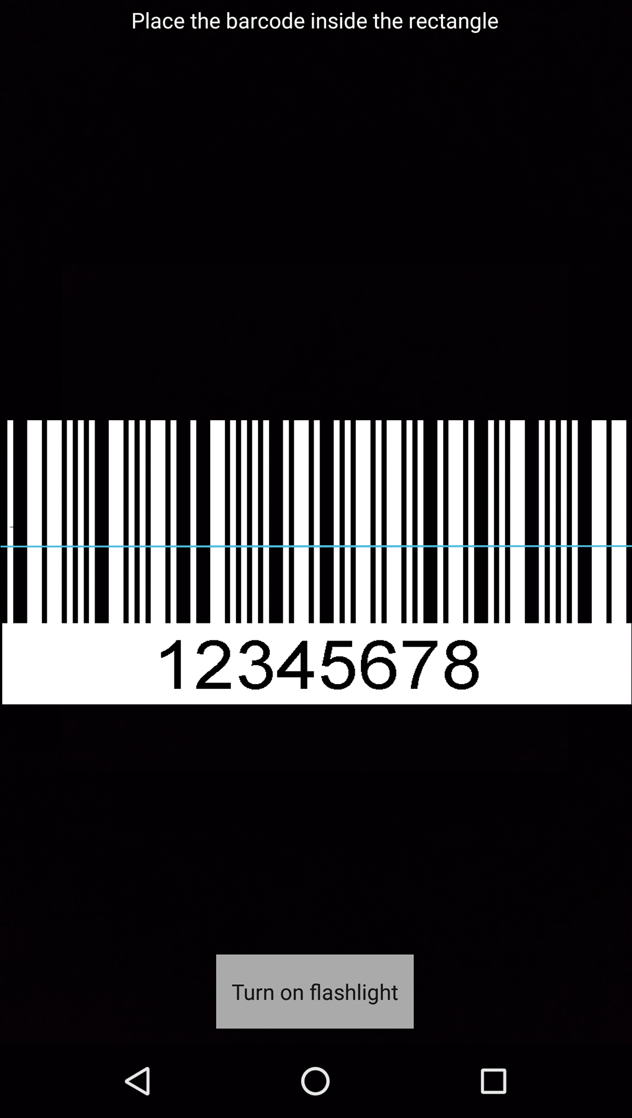
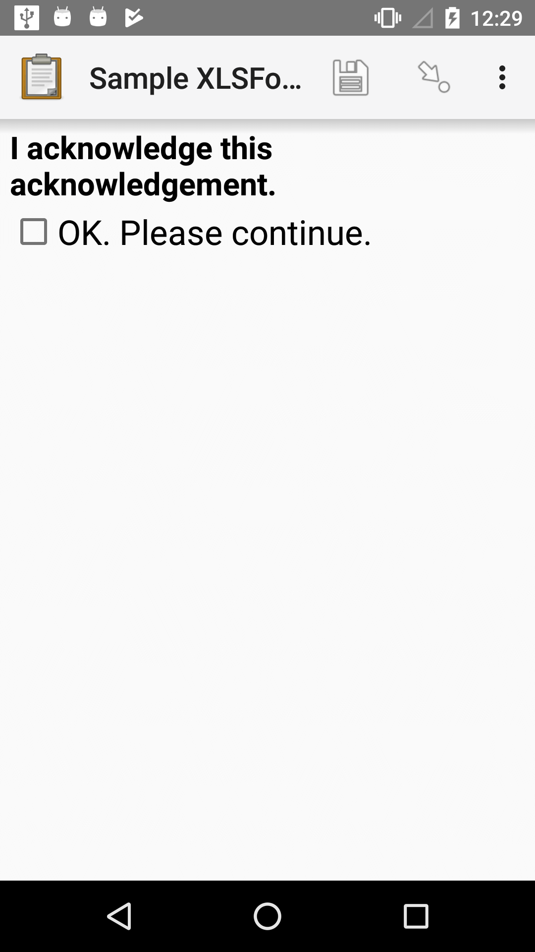
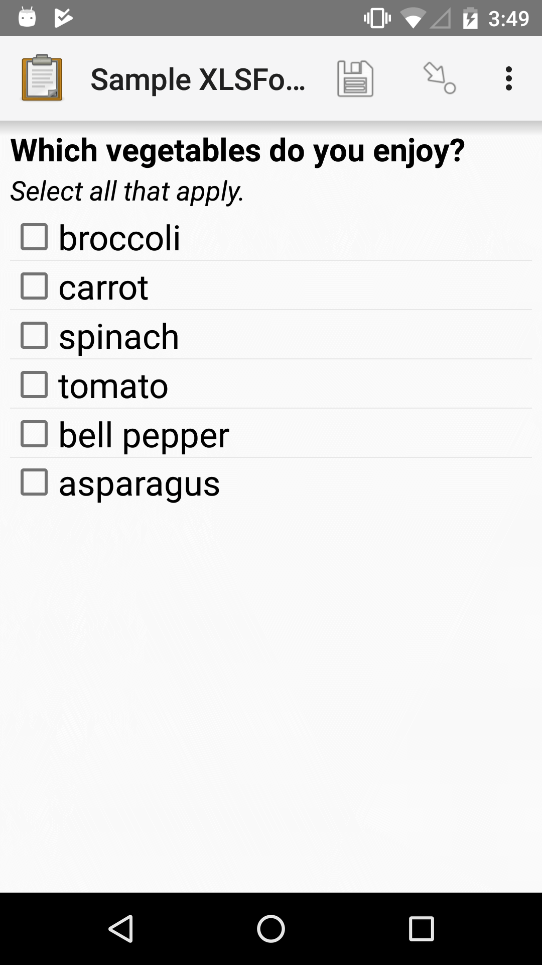
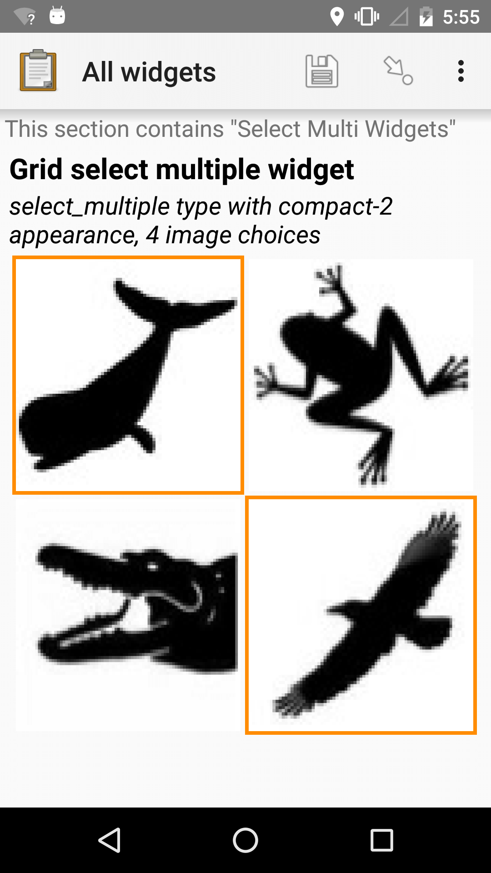
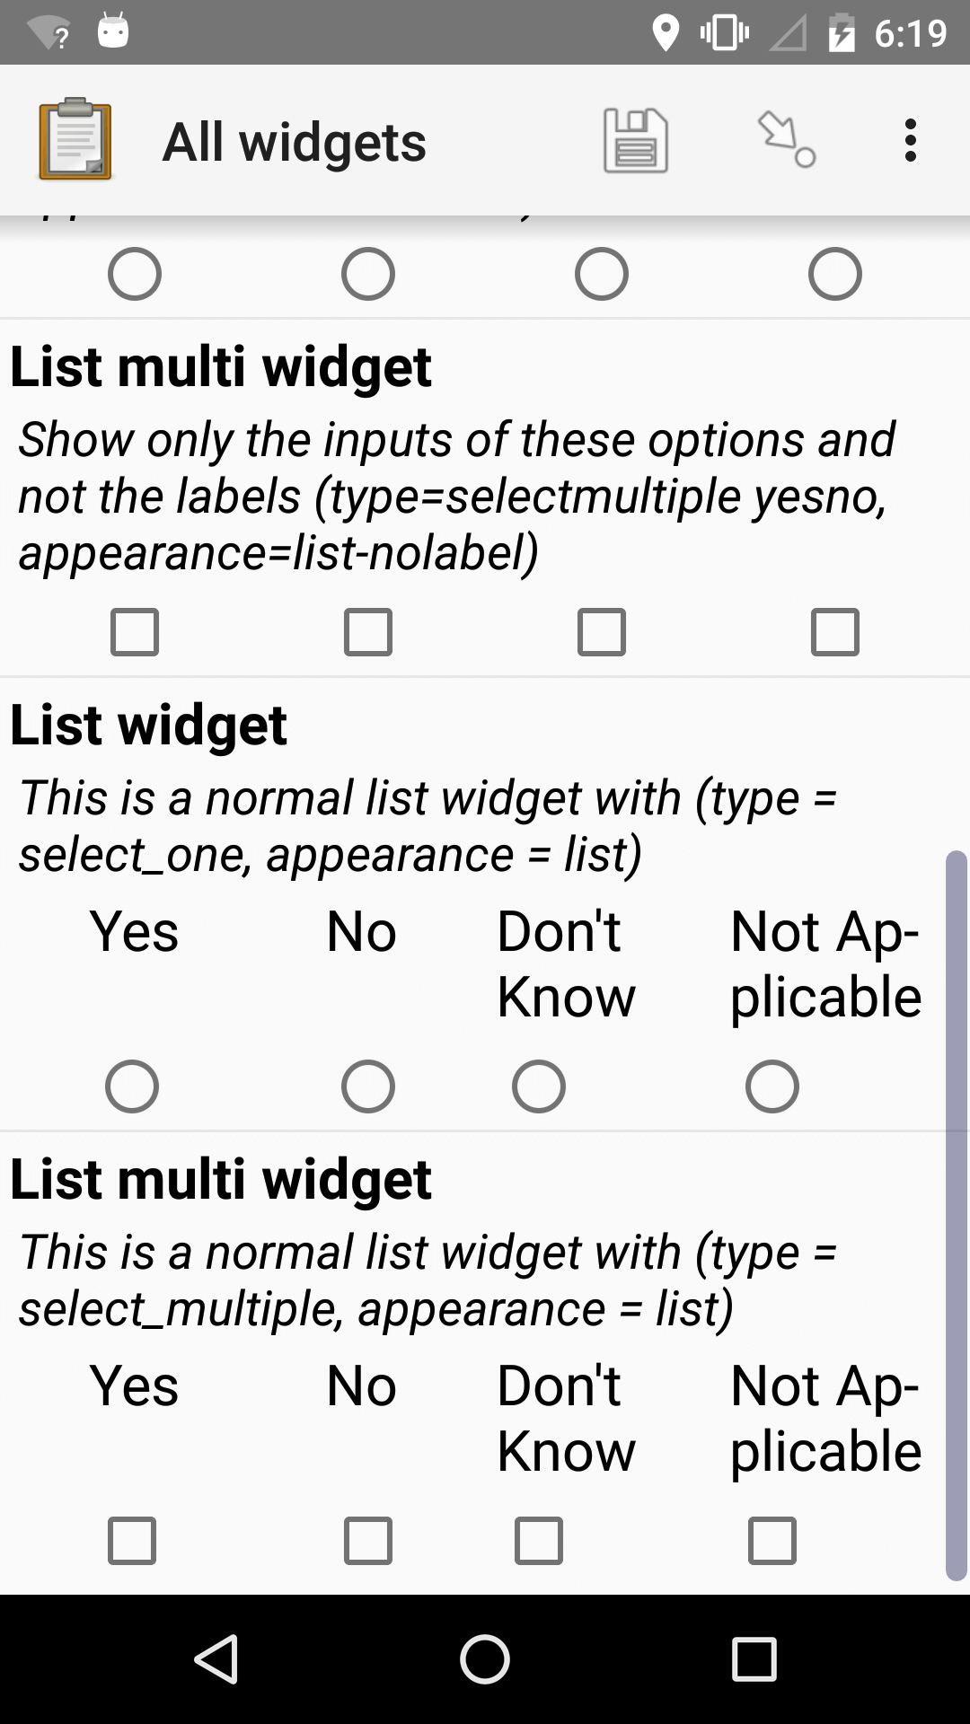
Collect
Use Android mobile devices to collect data and fill out digital forms:
Basic Data (text, numbers, time, date)
Barcode Scan
Select from list (one or many)
Media (photos, video, audio)
GPS/Geo data (locations, routes, areas)
No network connection required to collect data and fill out forms. Forms can be uploaded at a later time when a connection is available.

Slide 8
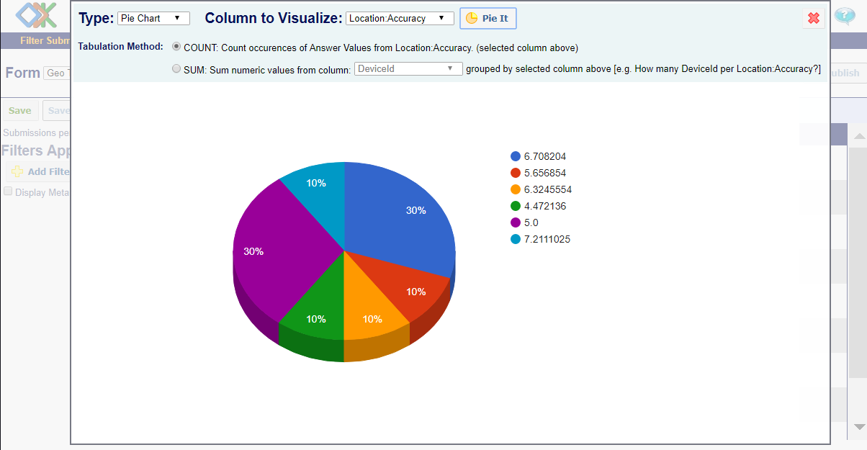
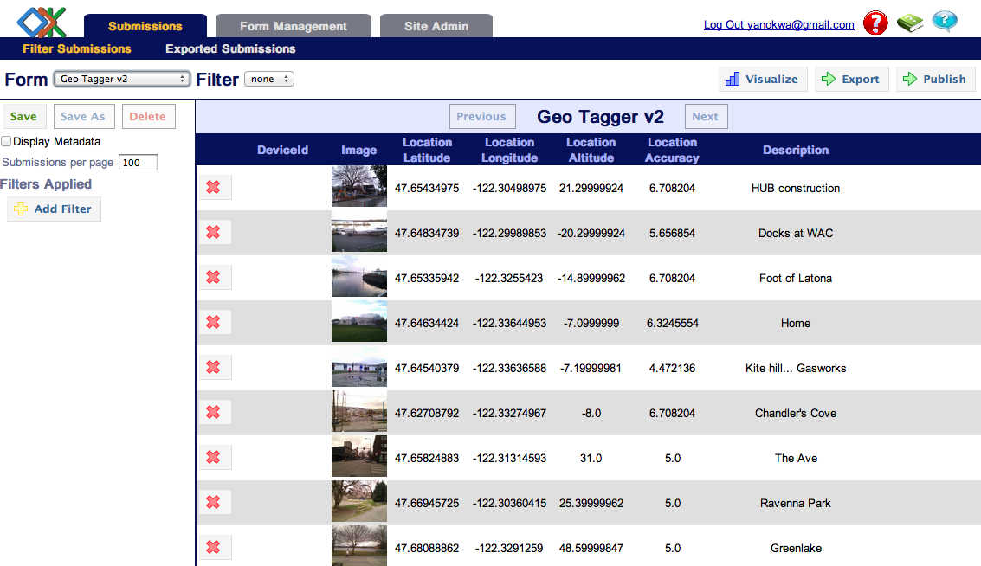
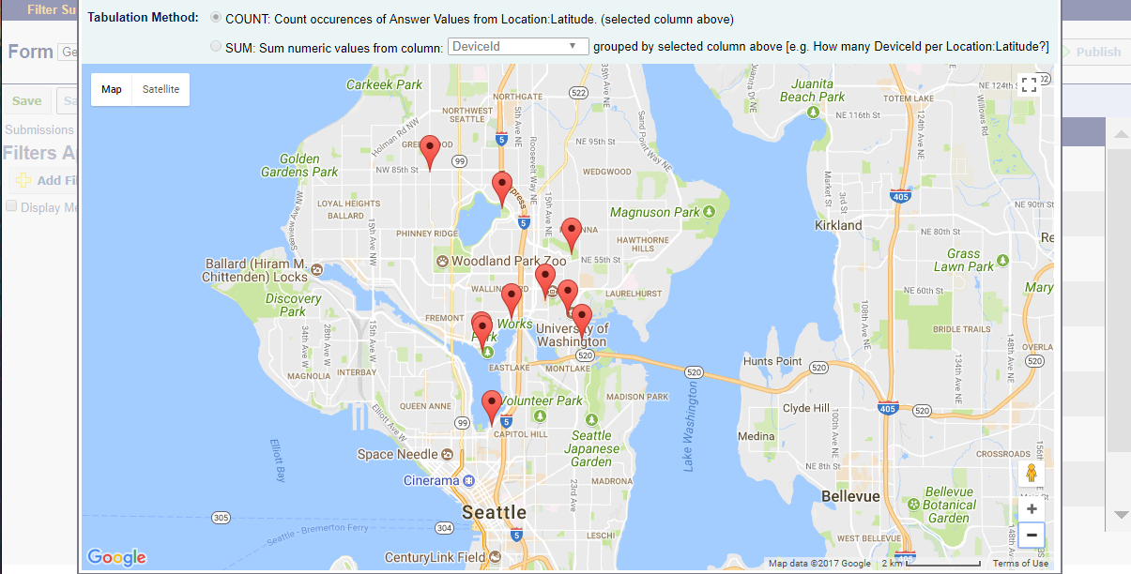
Aggregate
Manage and maintain forms
Search, review, filter, and organized data
Analyze and visualize data using maps, graphs, and charts
Export data to spreadsheets
Publish data to external systems
Manage Users and Permissions levels

Slide 9
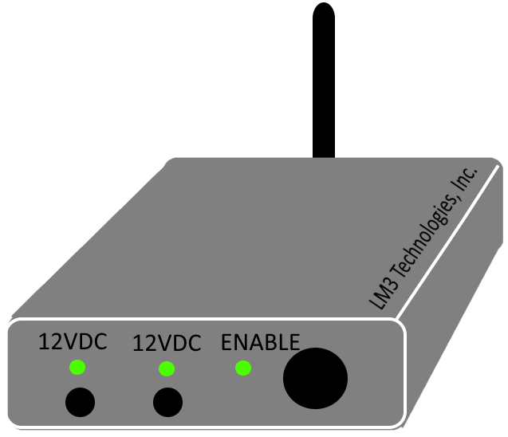
Control
Control production machines based on data conditions via relay.
Connect to control boxes over WIFI or LAN.

Slide 10
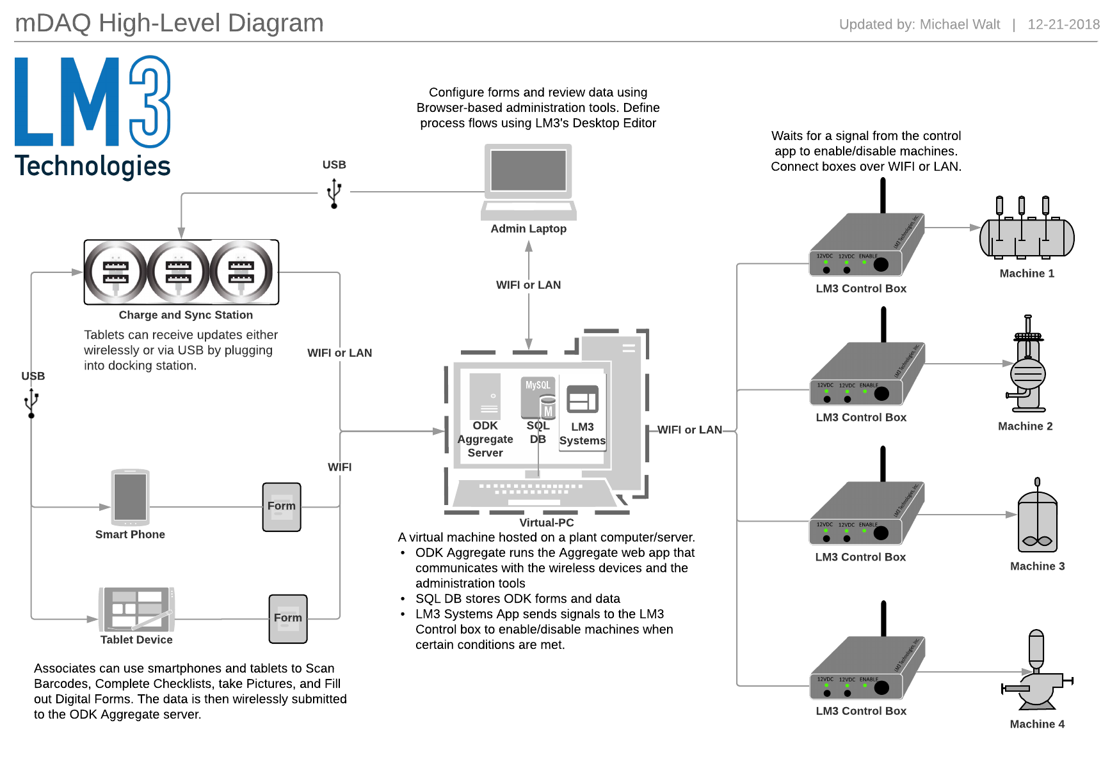
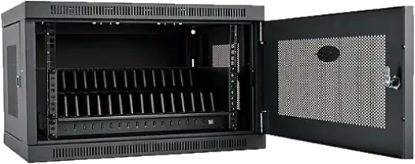
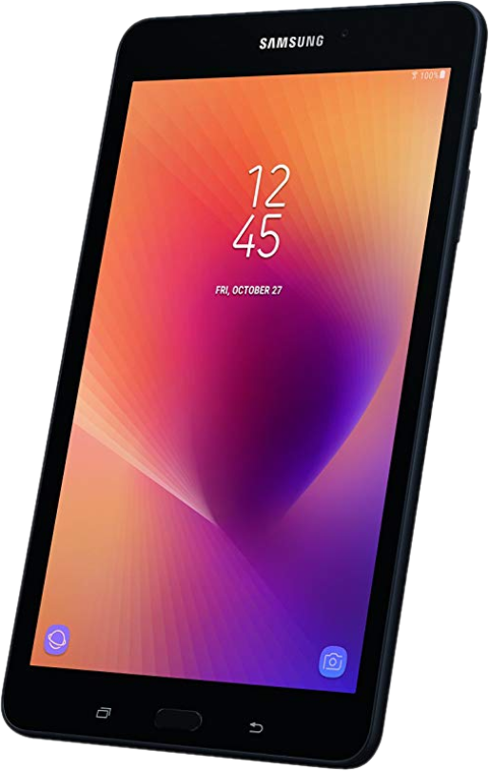

Slide 11
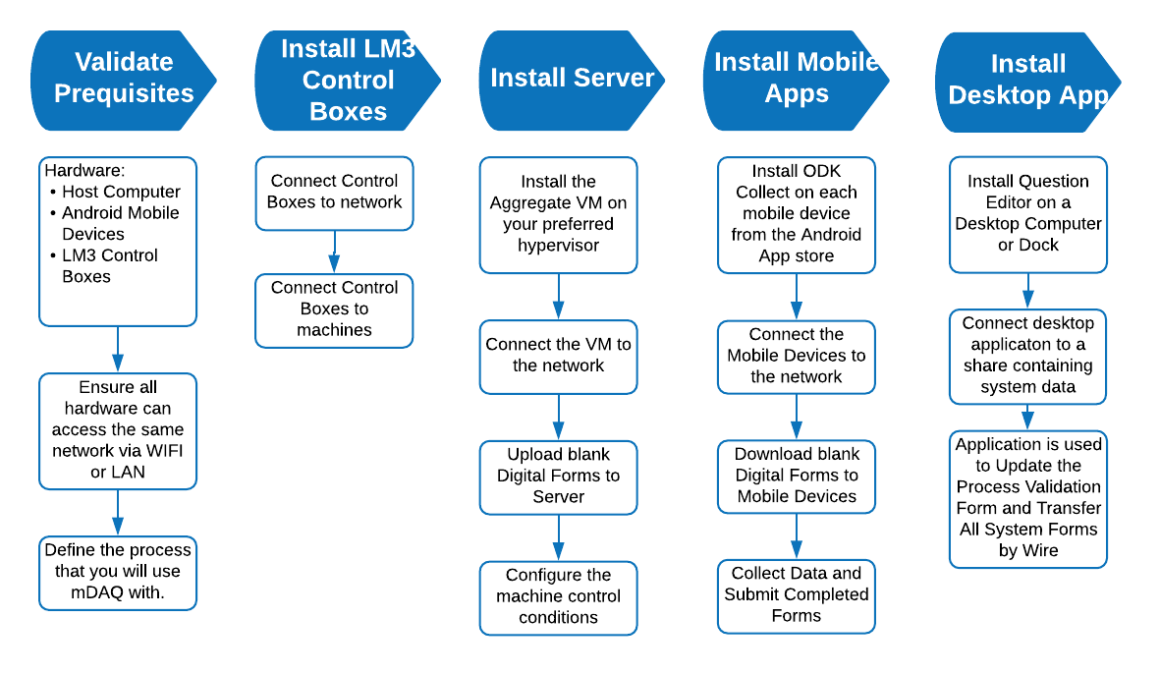
Deployment and Installation process

Slide 12
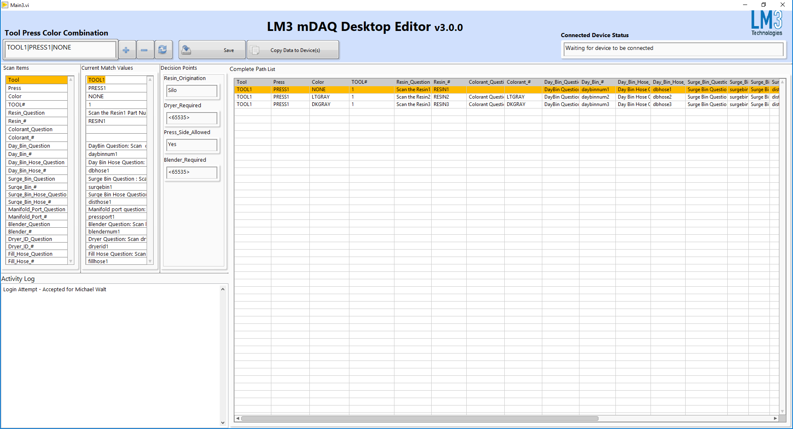
Question and flow editor

Slide 13
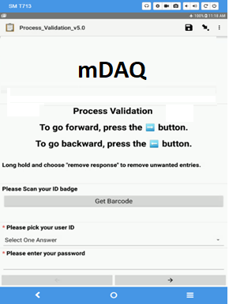
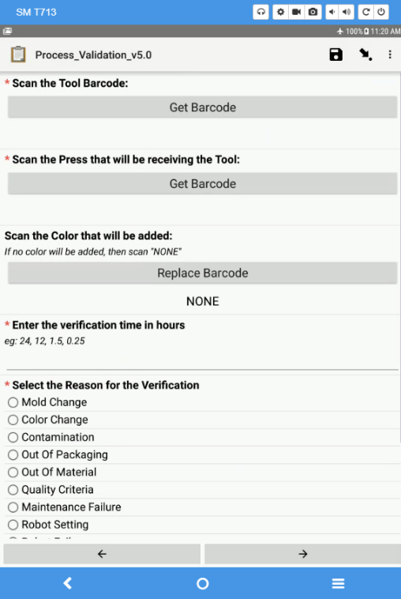
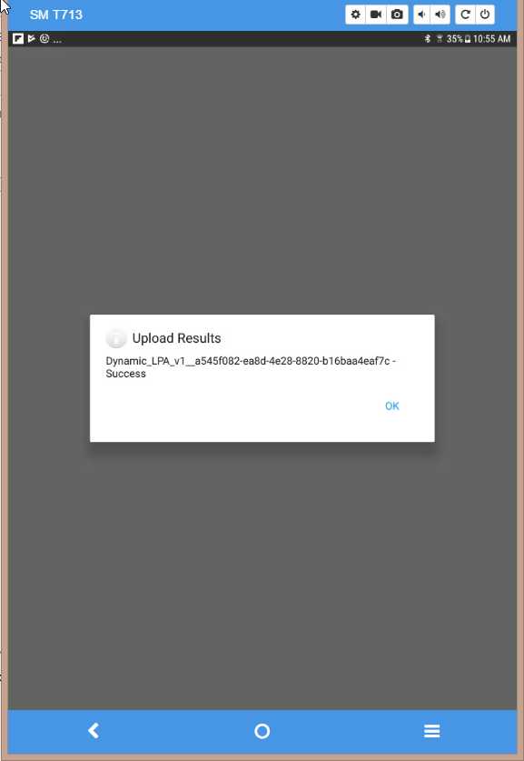
Mobile device data collection for process validation
=
Validated Proces, Usable Machine, and Satisfied Customer
User logs in for accountability
User completes process validation
User submits collected data

Slide 14
System Components and Requirements
Components
Android Mobile Devices
mDAQ Control Boxes
Android App
ODK Collect
Host Server Software
ODK Aggregate
SQL Database
mDAQ Control Software
Desktop Software – Question Editor
Variants
ESXi or HyperV VM Package
Software Installed Directly on a Server
MSSQL Express or Full Back End
Requirements
Area with available wireless network using IPv4
64-bit Host Server
CPU: 2 GHz or faster
RAM: 4 GB or more
HDD: 20 GB or more
64-bit Host Computer to run Question Editor
Shared Network Folder to House Form Data

